Slide 1

Project Title -Seasonal Agriculture Performance Analysis
Student Name: Deekshidha Bakthavachalam
College Name: Manakula Vinayagar Institute of Technology
AICTE STU ID : STU673ca0bb770e41732026555

Slide 2

PROBLEM STATEMENT
Agricultural activities are heavily influenced by seasonal variations in environmental conditions, farming practices, resource availability, and market dynamics.
However, raw agricultural data does not clearly explain how performance metrics change across distinct seasons or what actionable patterns exist.
Core Challenge: Analyze the agricultural dataset to investigate seasonal differences in crop yield, output, and efficiency by identifying meaningful patterns, correlations, and trends.

Slide 3
Project Description Data Processing & Cleaning Engineered raw agricultural records to handle missing values, formatted seasonal categorization (Kharif, Rabi, Zaid, Whole Year), and computed normalized yield per unit area (kg/hectare). Exploratory Visual Analytics Deployed statistical visualization tools to uncover yield disparities, environmental correlations (rainfall, temperature), and production volume fluctuations across varied regional conditions.

Slide 4

WHO ARE THE END USERS?
Farmers & Agronomists
Gain direct guidance on optimal crop selection and planting schedules based on historical seasonal performance data.
Policy Makers
Formulate data-driven subsidies, crop insurance plans, and regional drought mitigation strategies for vulnerable seasons.
Agribusinesses
Optimize supply chain logistics, storage capacity allocation, and grain market pricing strategies ahead of peak harvests.

Slide 5

Technology Used
Category | Technologies & Tools | Project Purpose
Programming | Python 3.x | Core scripting, data manipulation, and calculation pipeline
Data Analysis | Pandas, NumPy | Data Wrangling, aggregation, missing value imputation, indexing
Data Visualization | Matplotlib, Seaborn, Plotly | Bar charts, distribution plots, correlation heatmaps, interactive charts
Environment & Versioning | Jupyter Notebook, Git, GitHub | Interactive EDA, version control, code documentation & repository hosting

Slide 6
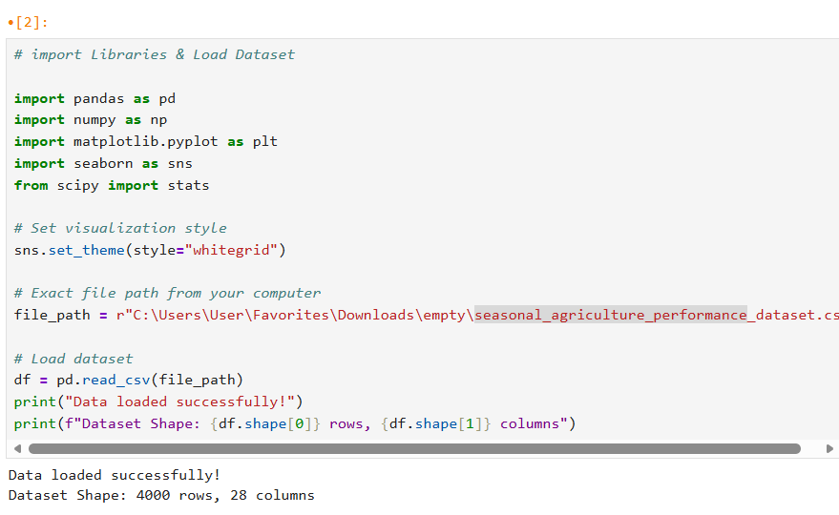
RESULTS

Slide 7
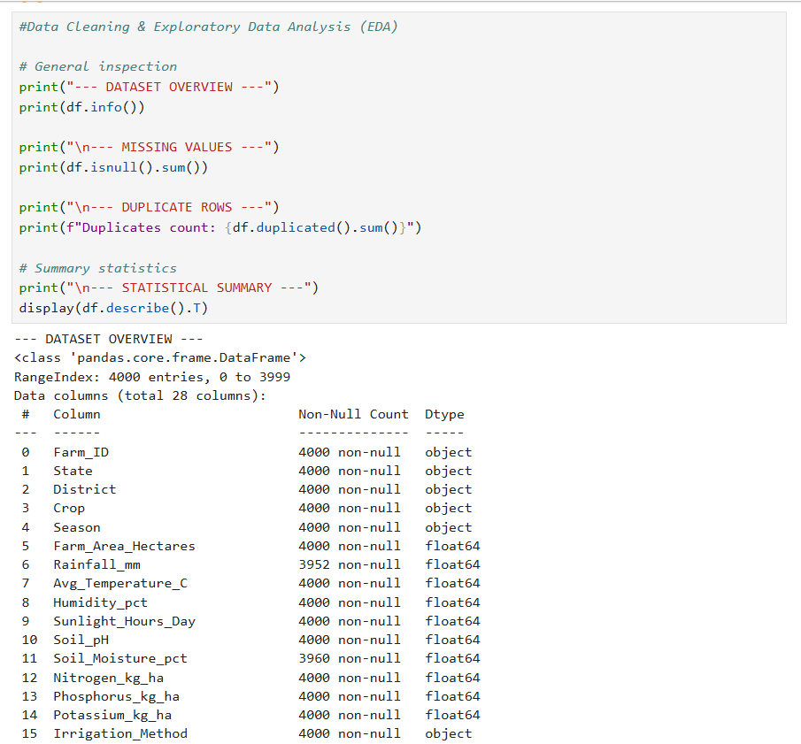
RESULTS

Slide 8
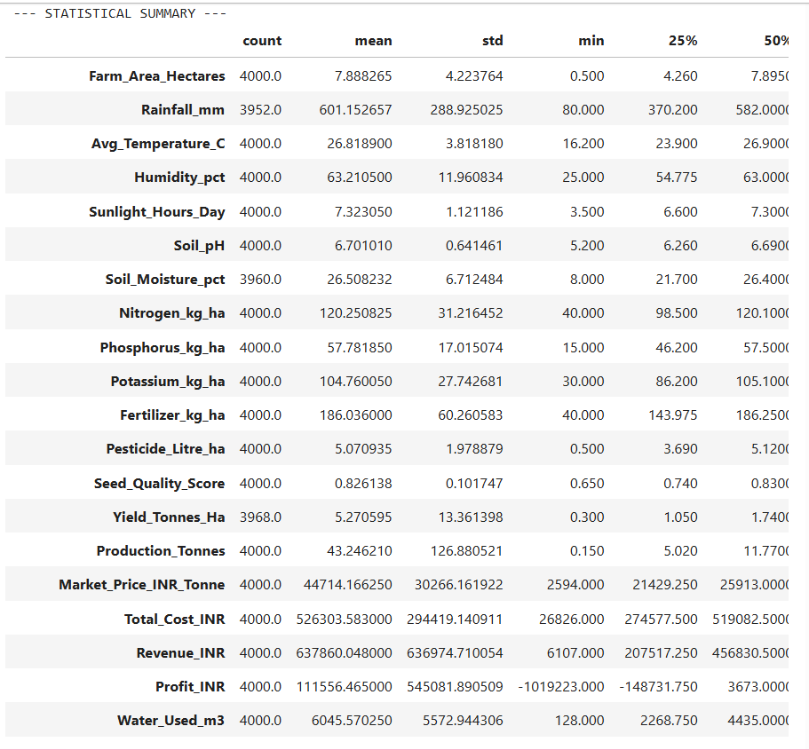
RESULTS

Slide 9
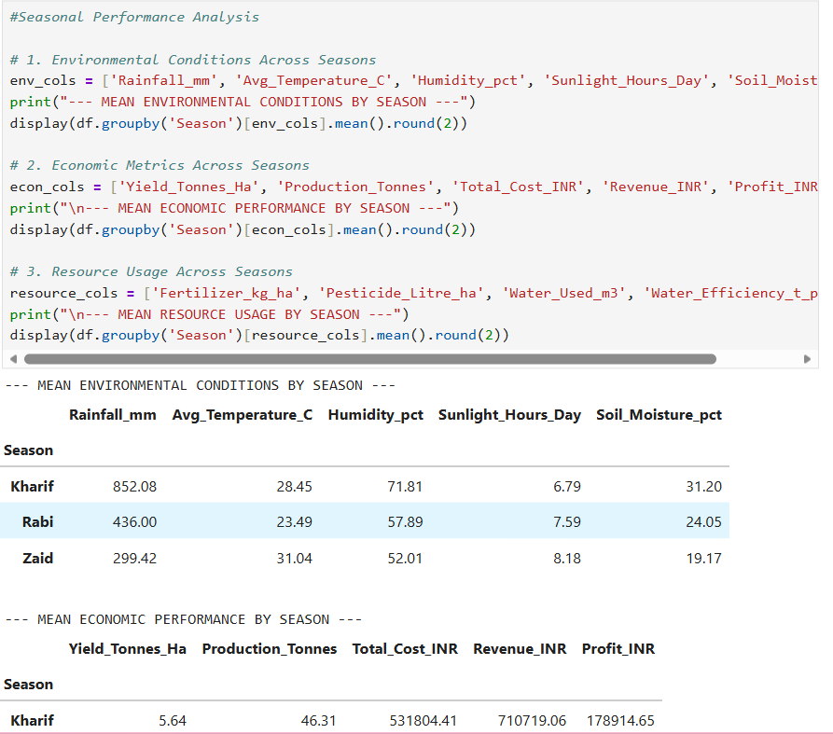
RESULTS

Slide 10
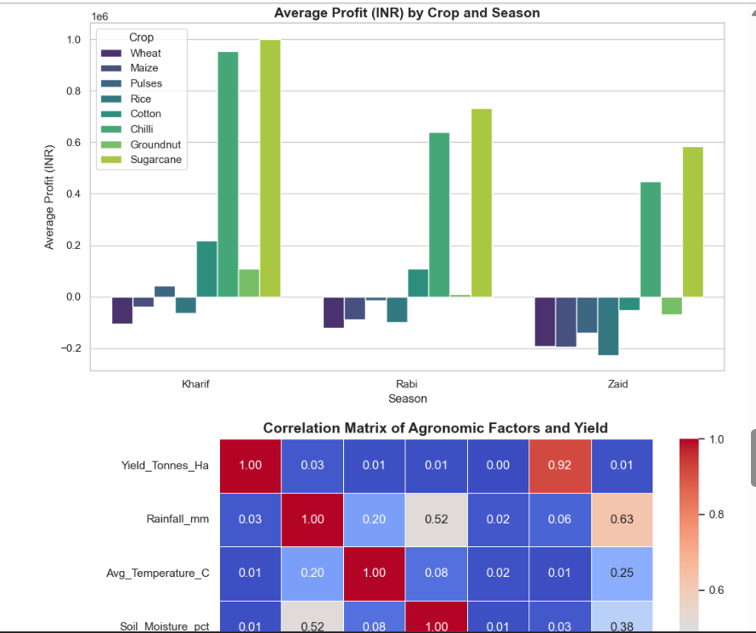
RESULTS
[Add screen shots of your code ]

Slide 11
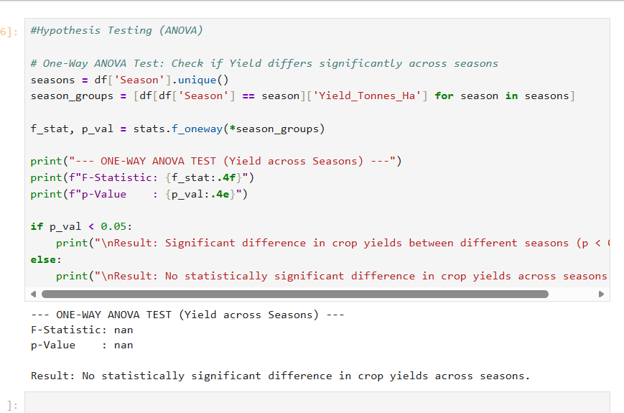
RESULTS

Slide 12
Future scope
Real-Time Weather
Integrate live meteorological APIs for dynamic climate risk mapping.
Predictive ML
Build Machine Learning models (Random Forest, XGBoost) for crop yield estimation.
GIS Mapping
Incorporate spatial satellite data for geographical crop condition tracking.
Mobile App
Develop lightweight mobile advisory app for direct farmer deployment.

Slide 13
GitHub Link
https://github.com/Deekshidhab/Seasonal-Agriculture-Performance-Analysis

Slide 14
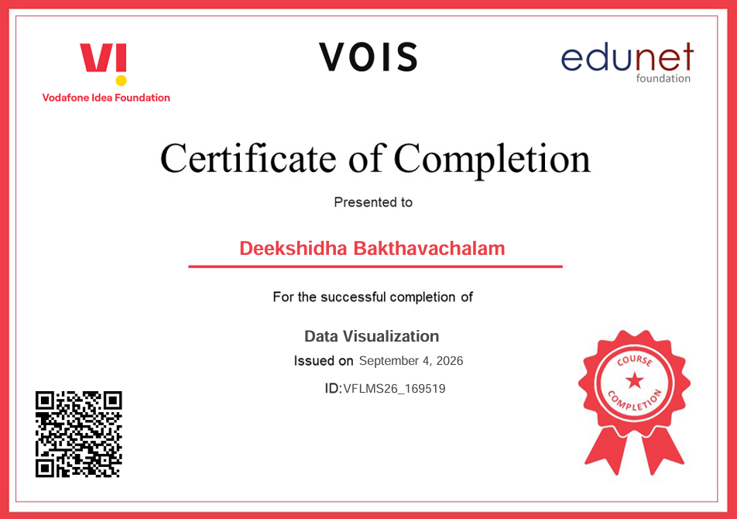
VOIS Course completion certificate - Course name- Data Visualization

Slide 15
Thank you
- By Deekshidha Bakthavachalam
.
.

